Slide 1


BE Project Presentation On “Commodity Stock Recommendations and Price Prediction using Prescriptive Analytics Techniques ”
Smt. Kashibai Navale College of Engineering,Pune
Presented by
Harish Hatmode 18U424 Guided
Pragati Bankar 18U417 By
Vishal Wankhede 18U420 Dr. K. N. Honwadkar
Onkar Kulkarni 18U426

Slide 2
Outline
Software Development Model
Architecture Diagram
Class Diagram
Component Diagram
State Diagram

Slide 3
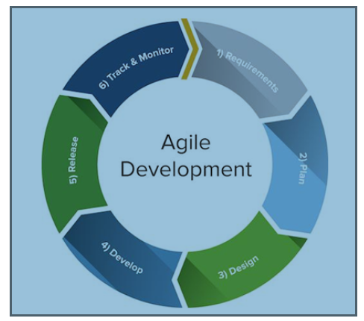
Software Development Model

Slide 4
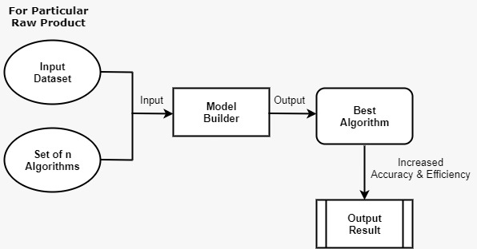
Architectural Model

Slide 5
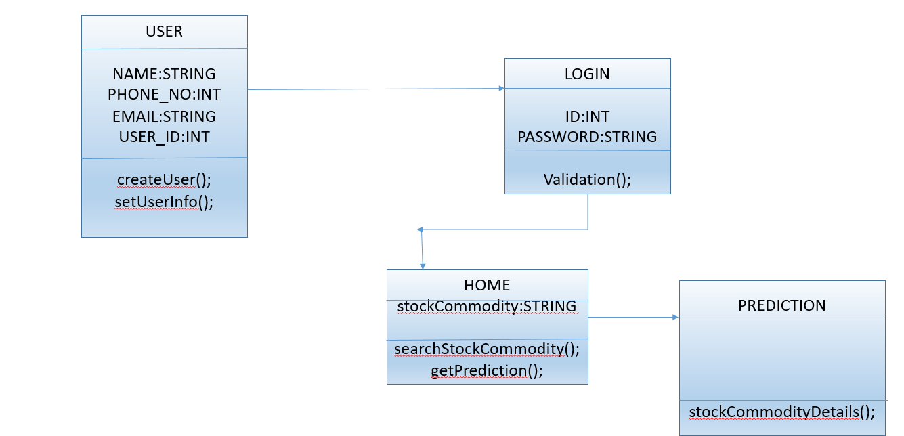
Activity Diagram

Slide 6
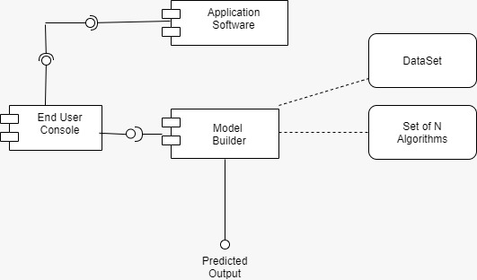
Component Diagram

Slide 7
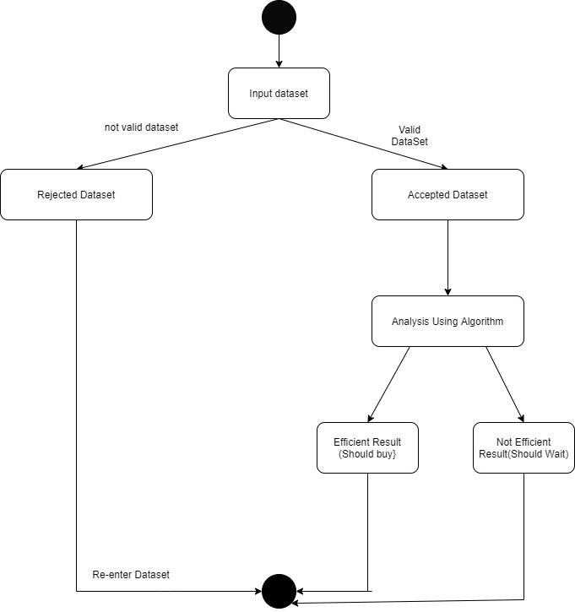
State Diagram

Slide 8


